Slide 1
Introduction to Computational Thermodynamics
Section 1.3
Numerical Methods

Slide 2
Introduction
In a course about computational thermodynamics, it’s important to have an idea of the numerical methods available
However, this is not a course on numerical methods – this discussion aims to be a brief overview of some of the methods and terminology you will encounter over the next three sessions

Slide 3
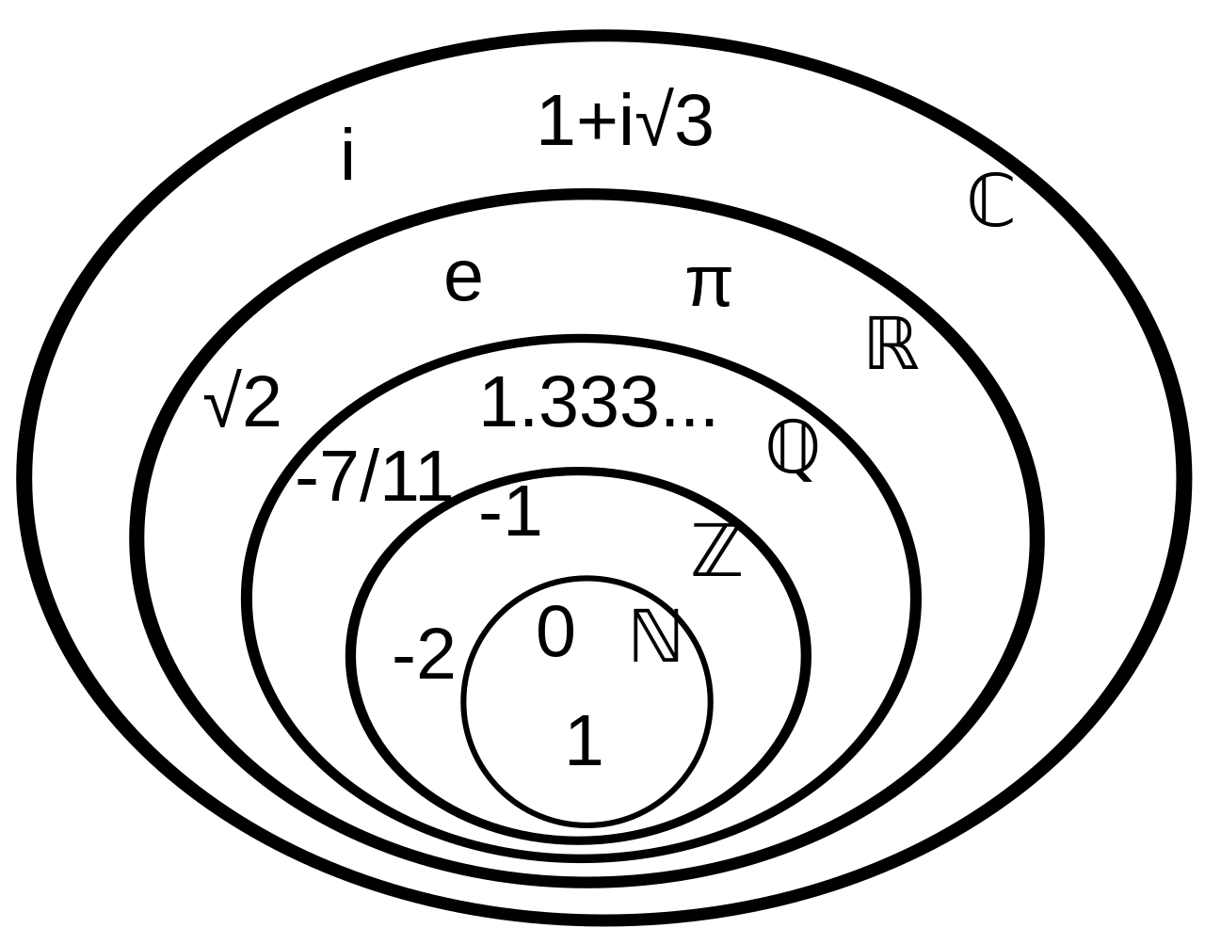
Mathematical Notation
Before getting into the numerical methods, we should review some definitions from multivariable calculus
A set is a collection of unique elements. There are a few common sets you should be familiar with
courtesy of Wikipedia

Slide 4
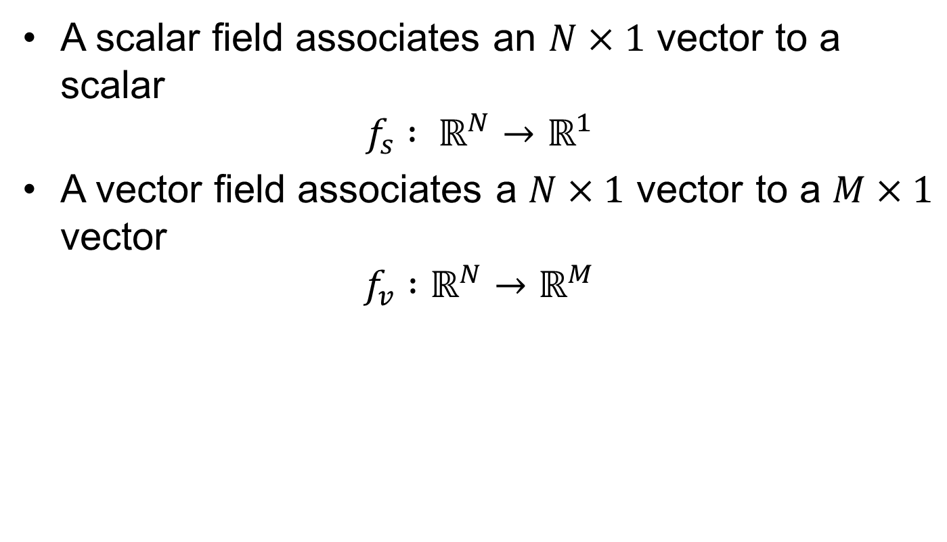
Mathematical Notation
A scalar field associates an $N×1$ vector to a scalar
$$f_{s} : ℝ^{N}→ℝ^{1}$$
A vector field associates a $N×1$ vector to a $M×1$ vector
$$f_{v} :ℝ^{N}→ℝ^{M}$$
Notes:
Describe what the

Slide 5
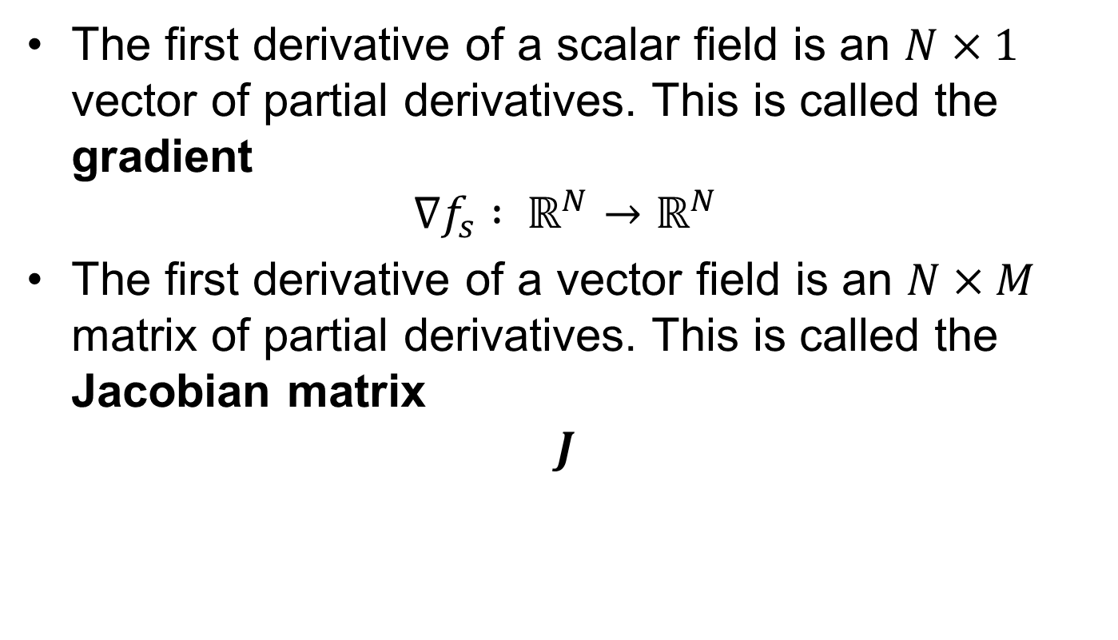
Mathematical Notation
The first derivative of a scalar field is an $N×1$ vector of partial derivatives. This is called the gradient
$$∇f_{s} : ℝ^{N}→ℝ^{N}$$
The first derivative of a vector field is an $N×M$ matrix of partial derivatives. This is called the Jacobian matrix
$$J$$

Slide 6
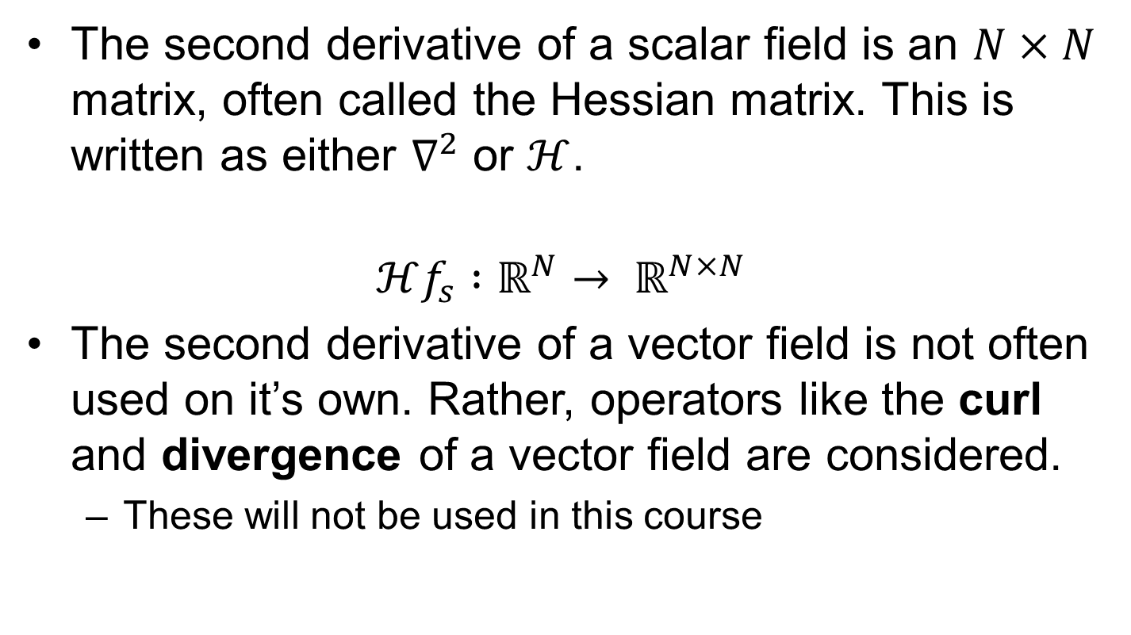
Mathematical Notation
The second derivative of a scalar field is an $N×N$ matrix, often called the Hessian matrix. This is written as either $∇^{2}$ or $ℋ$.
$$ℋf_{s} :ℝ^{N}→ ℝ^{N×N}$$
The second derivative of a vector field is not often used on it’s own. Rather, operators like the curl and divergence of a vector field are considered.
These will not be used in this course

Slide 7
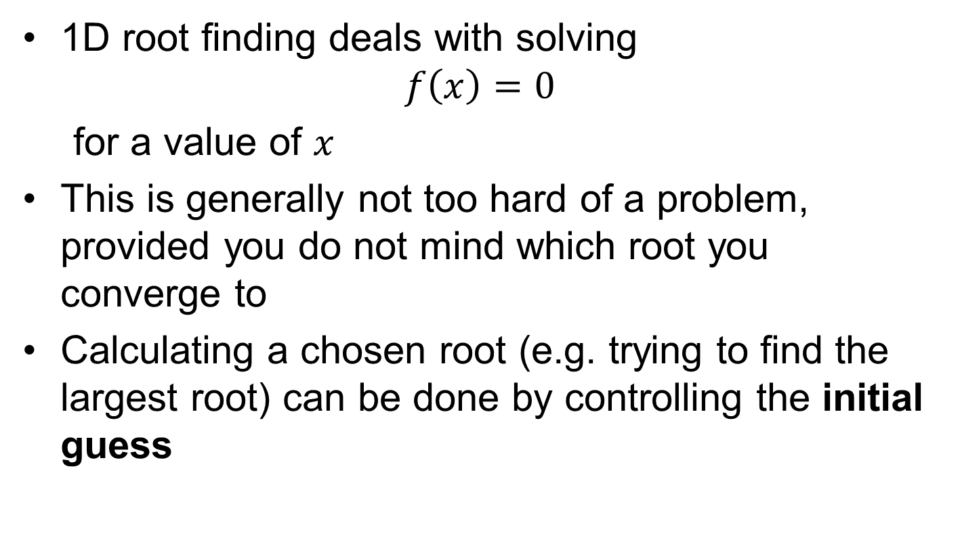
Root Finding
1D root finding deals with solving $f\left(x\right)=0$
for a value of $x$
This is generally not too hard of a problem, provided you do not mind which root you converge to
Calculating a chosen root (e.g. trying to find the largest root) can be done by controlling the initial guess

Slide 8
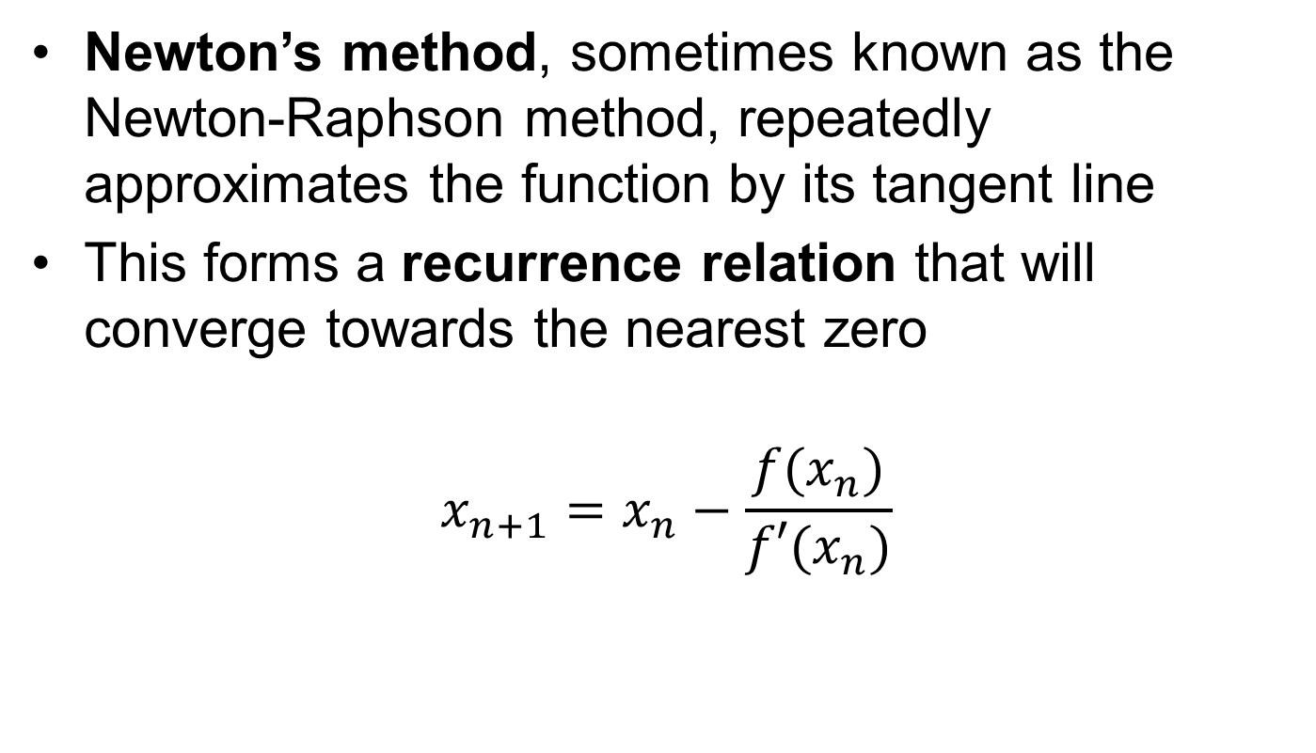
Newton’s method
Newton’s method, sometimes known as the Newton-Raphson method, repeatedly approximates the function by its tangent line
This forms a recurrence relation that will converge towards the nearest zero
$$x_{n+1}=x_{n}−\frac{f(x_{n})}{f′(x_{n})}$$

Slide 9
Newton’s method
Graph showing successive linear approximations

Slide 10
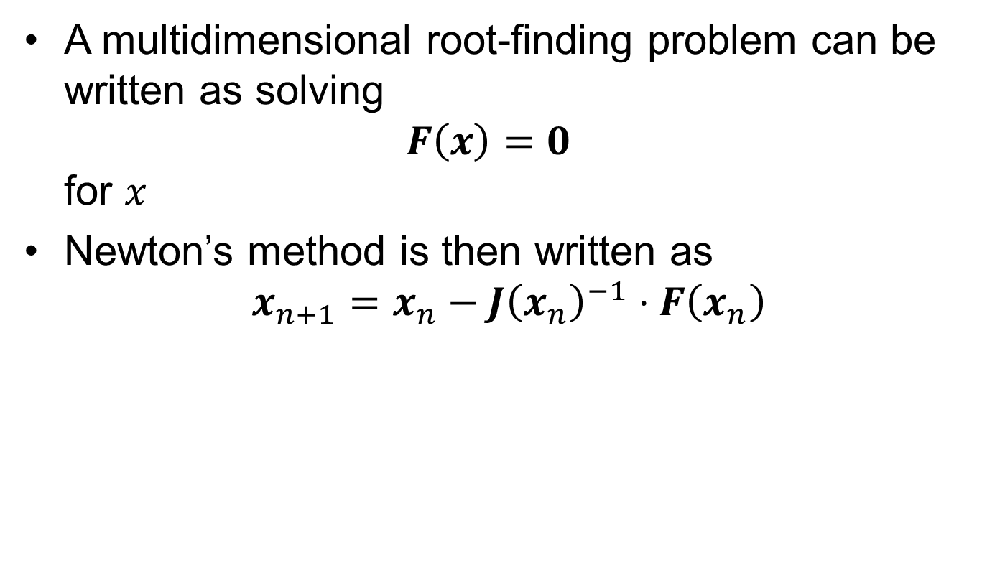
Newton’s method
A multidimensional root-finding problem can be written as solving $F\left(x\right)=0$ for $x$
Newton’s method is then written as $x_{n+1}=x_{n}−J{\left(x_{n}\right)}^{−1}⋅F\left(x_{n}\right)$

Slide 11
Convergence Characteristics
Newton’s method is locally convergent
a “good” initial point is required for the method to arrive at a root successfully
Modifications do exist that allow for the method to become globally convergent
Describing these is beyond the scope of this course. The typical classes of modifications are
Line search
Trust region

Slide 12
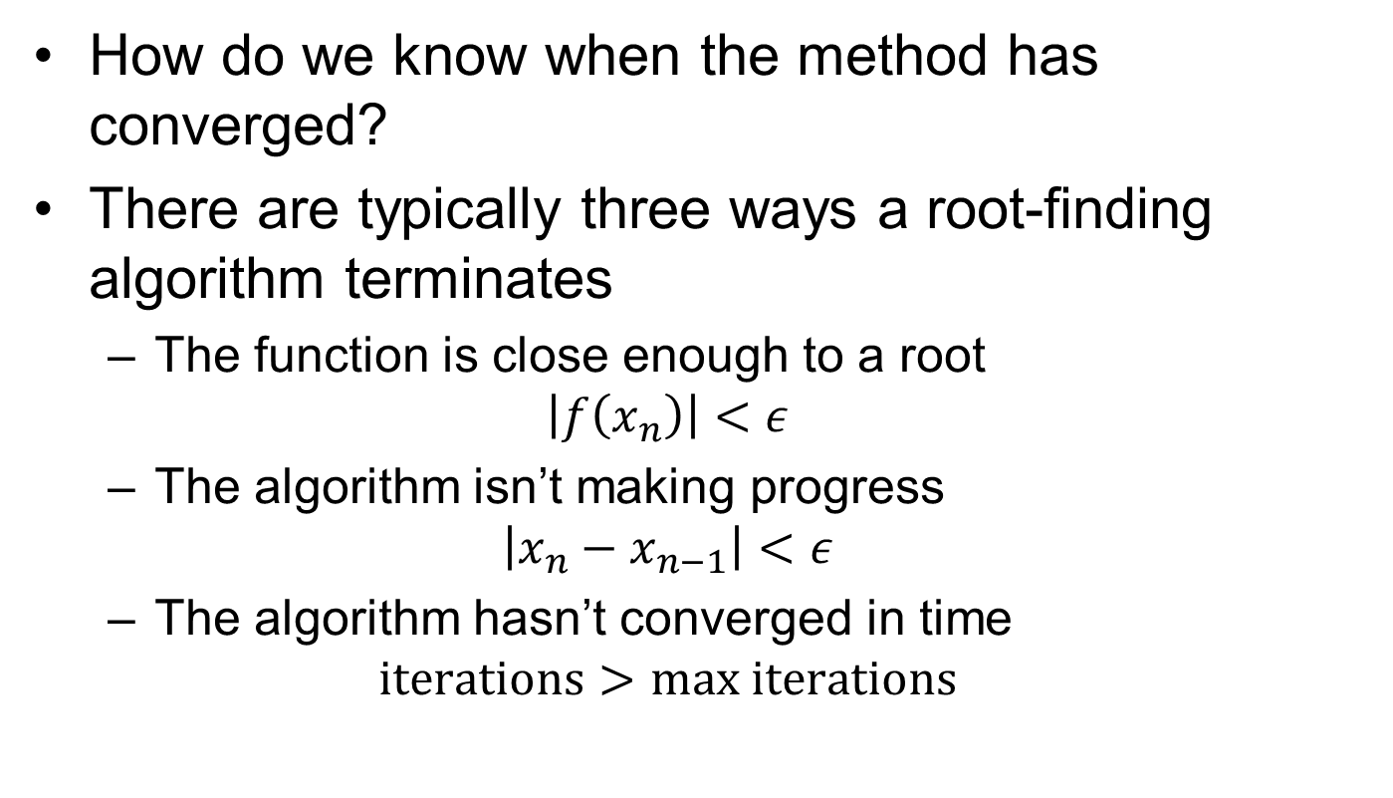
Convergence
How do we know when the method has converged?
There are typically three ways a root-finding algorithm terminates
The function is close enough to a root $\left|f\left(x_{n}\right)\right|<ε$
The algorithm isn’t making progress $\left|x_{n}−x_{n−1}\right|<ε$
The algorithm hasn’t converged in time $iterations>max iterations$

Slide 13
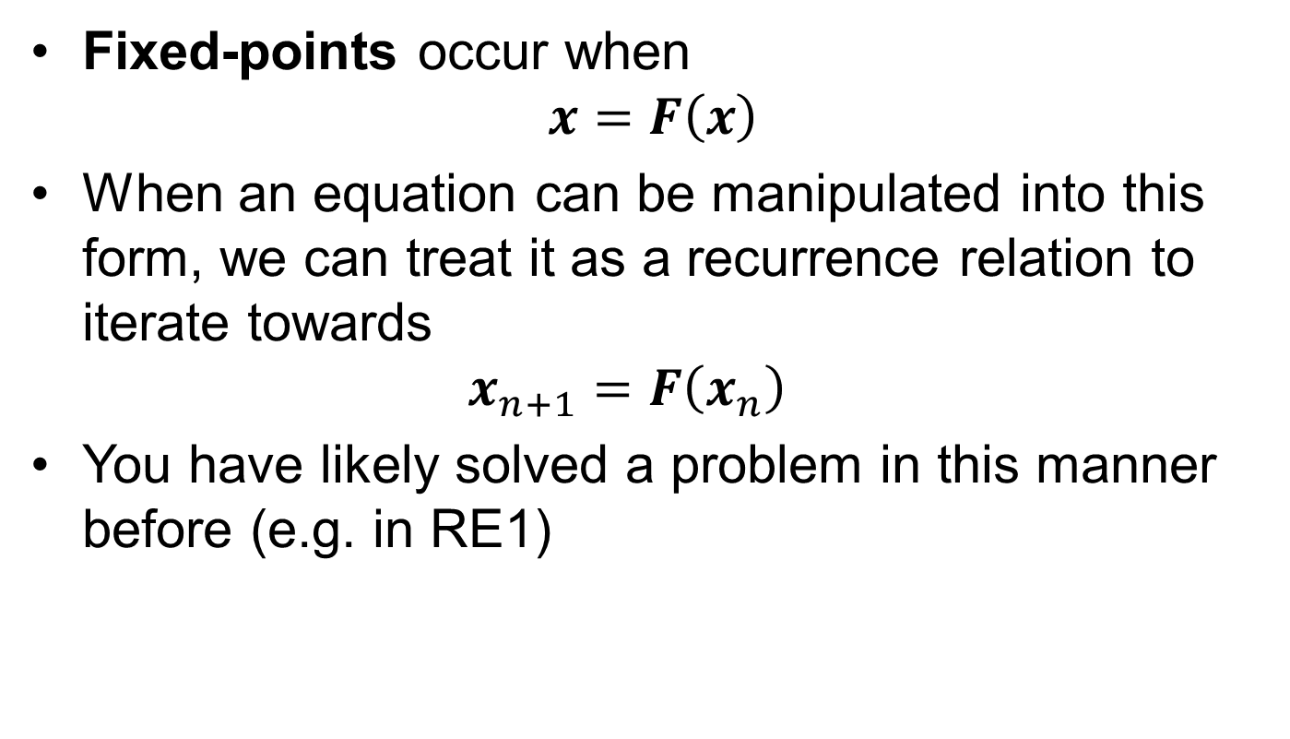
Successive Substitution
Fixed-points occur when $x=F\left(x\right)$
When an equation can be manipulated into this form, we can treat it as a recurrence relation to iterate towards $x_{n+1}=F\left(x_{n}\right)$
You have likely solved a problem in this manner before (e.g. in RE1)

Slide 14
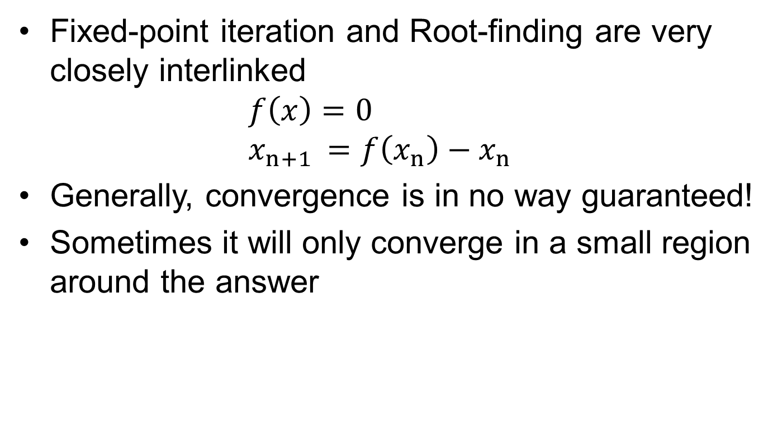
Successive Substitution
Fixed-point iteration and Root-finding are very closely interlinked $f\left(x\right)=0$ $x_{n+1 }=f\left(x_{n}\right)−x_{n}$
Generally, convergence is in no way guaranteed!
Sometimes it will only converge in a small region around the answer

Slide 15
Optimisation
Optimisation algorithms attempt to solve for maximum and minimum points
It’s split into local and global optimisation
Local optimisation is equivalent to root-finding
Global optimisation is problem-dependent, and often very difficult

Slide 16
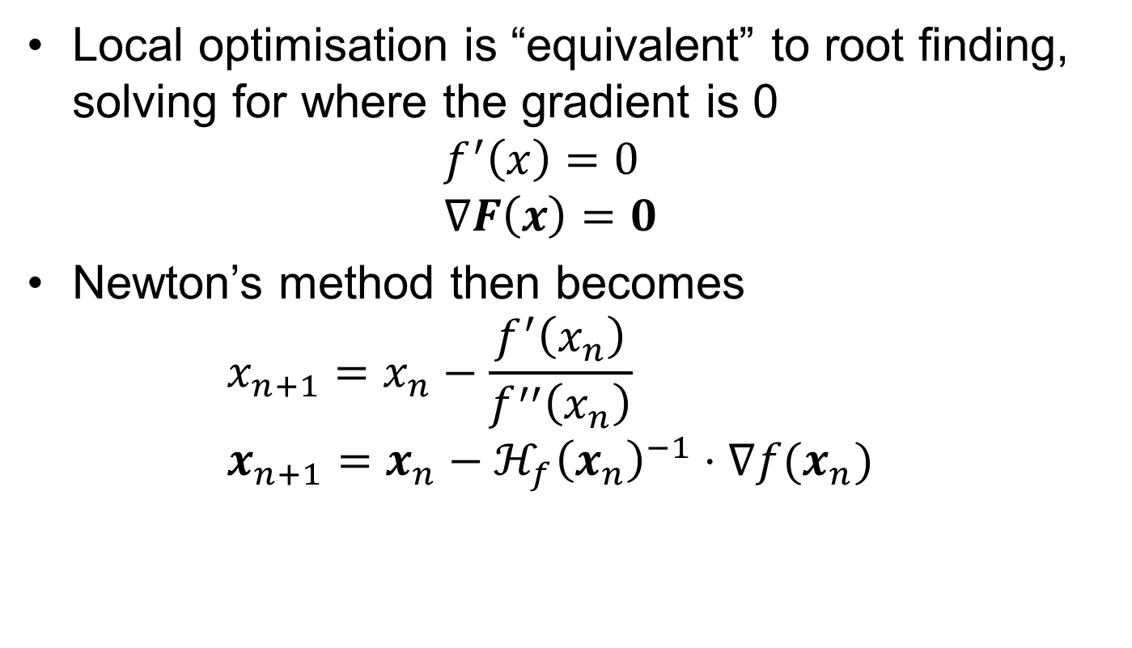
Optimisation
Local optimisation is “equivalent” to root finding, solving for where the gradient is 0 $f^{′}\left(x\right)=0$ $∇F\left(x\right)=0$
Newton’s method then becomes $x_{n+1}=x_{n}−\frac{f^{′}\left(x_{n}\right)}{f^{′′}\left(x_{n}\right)}$ $x_{n+1}=x_{n}−ℋ_{f}{\left(x_{n}\right)}^{−1}⋅∇f(x_{n})$

Slide 17
Newton’s Method (Optimisation)
As this is applying Newton’s method to the first derivative, it is now approximating the function as locally quadratic, rather than locally linear.

Slide 18
Convergence
Convergence is decided by testing the difference between successive iterations

Slide 19
Automatic Differentiation
Automatic differentiation allows for exact derivatives of functions defined by computer-code
There are two main modes: Forward-mode and Reverse-mode
Forward-mode is more efficient for smaller numbers of variables (~ 100), while Reverse-mode is more efficient beyond that

Slide 20
Automatic Differentiation
Both can somewhat be considered as tracking the base operations occurring within the code, e.g. +/-/*/÷, and differentiating this expression symbolically
These methods are very powerful and very common in modern scientific computing

Slide 21
Automatic Differentiation
Julia code example of ForwardDiff.jl

Slide 22
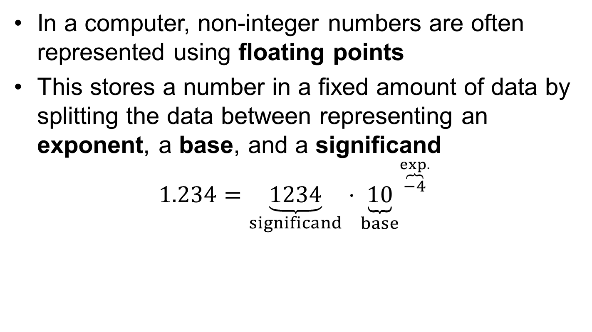
Floating-point Numbers
In a computer, non-integer numbers are often represented using floating points
This stores a number in a fixed amount of data by splitting the data between representing an exponent, a base, and a significand
$$1.234=\underset{significand}{\underbrace{1234}}⋅{\underset{base}{\underbrace{10}}}^{\overset{exp.}{\overbrace{−4}}}$$

Slide 23
Floating-point Arithmetic
While floating-point numbers carry a large number of advantages

